Slide 1
Distributed training in DGL
Da Zheng

Slide 2
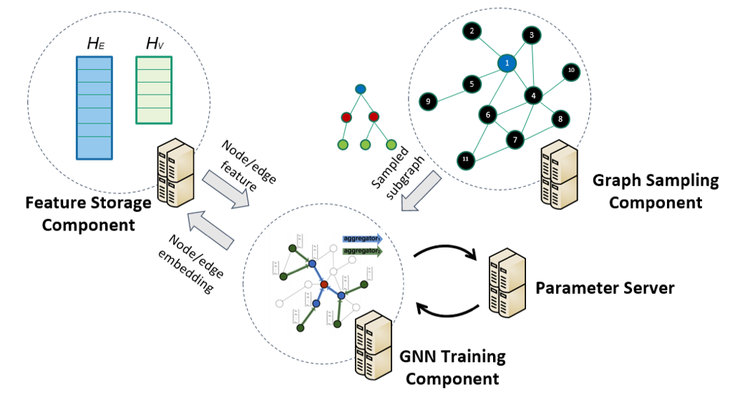
Overview
Fully distributed
Locality-aware partition
Strike for linear speedup
Minimize code change
Notes:
DGL provides full distributed design: all machines have the same function and parallelize training computation.
4 components:
* training component: ...
* sampling component: ...
* storage component: ...
* parameter server: ...

Slide 3
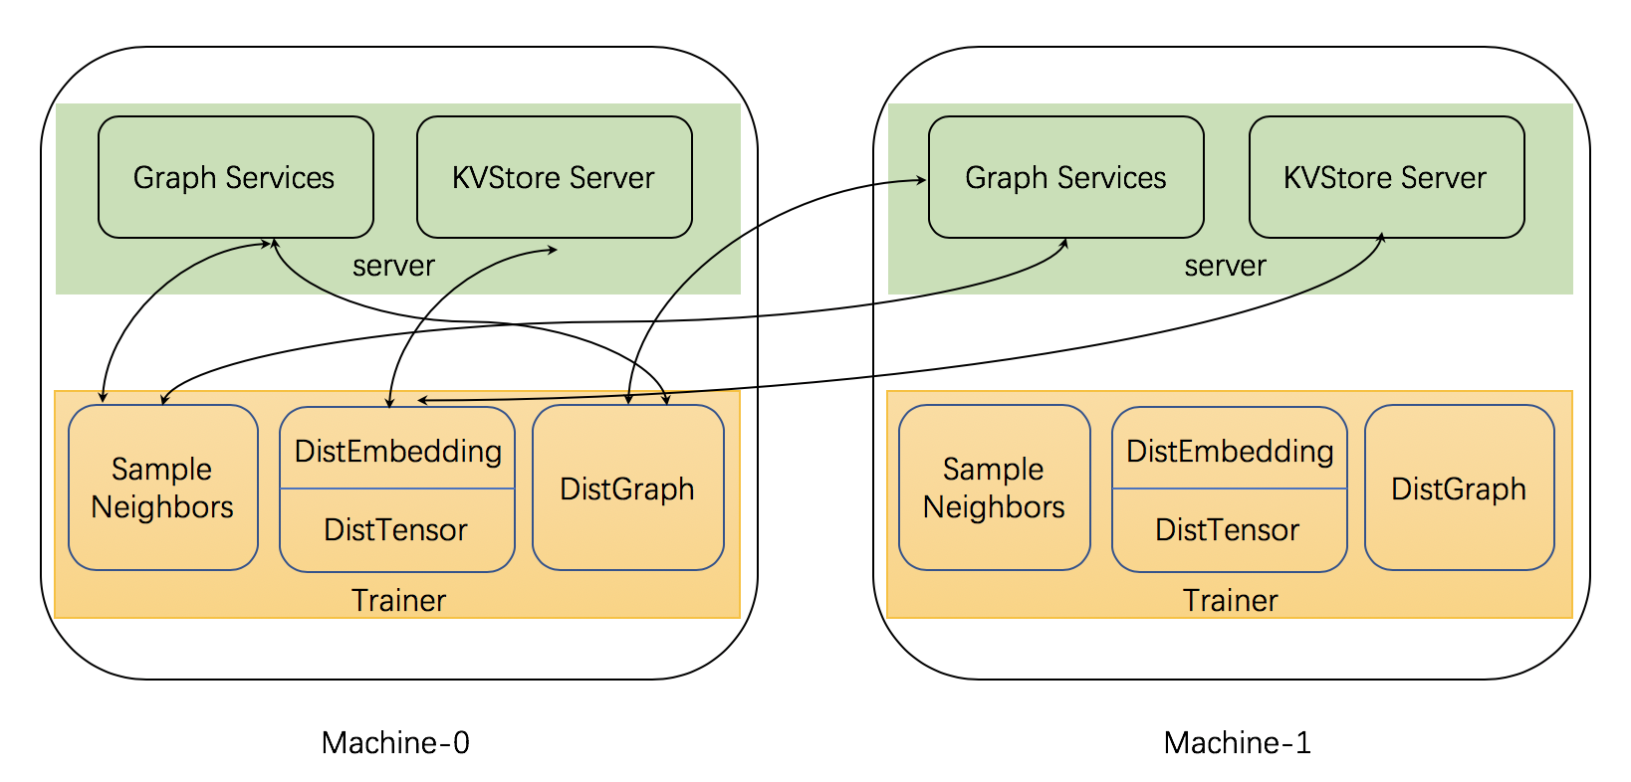
Distributed architecture
All machines run servers and trainers.
DGL partitions a graph and one machine is responsible for one partition.
Trainer processes access distributed data via:
DistGraph for both graph structure and node/edge data.
DistTensor and DistEmbedding accesses distributed tensors.
sample_neighbors samples subgraphs.

Slide 4
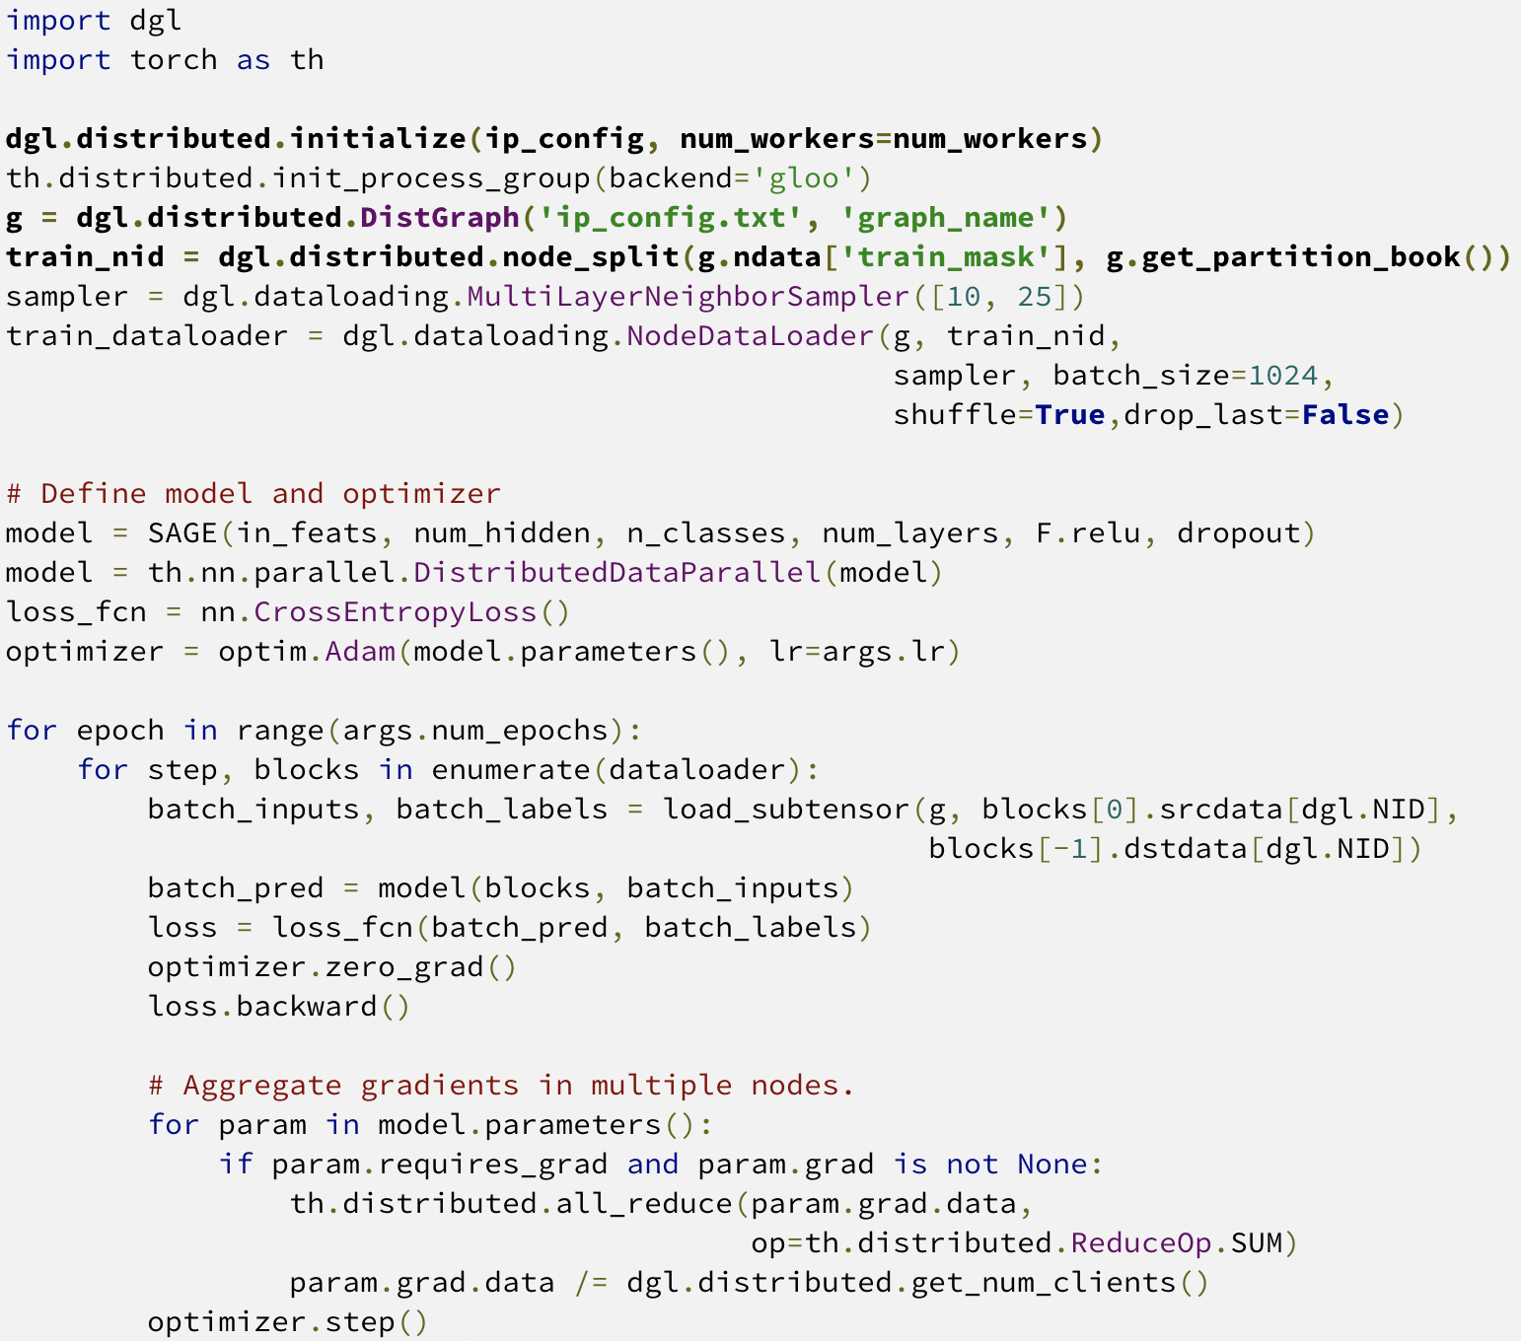
Overview of distributed training code
Little modification is required for distributed training.
Call initialize at the very beginning.
Use DistGraph for the distributed graph.
Use node_split to get a training subset for the trainer process.

Slide 5
Data preprocessing

Slide 6
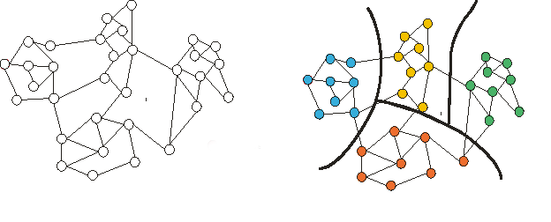
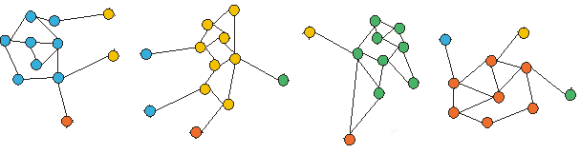
Graph partitioning
Two supported partitioning algorithms:
Metis
Random
Metis graph partitioning assigns nodes to partitions.
Minimize edge cuts
Split the graph into subgraphs (partitions); one partition per machine.
metis
Split graph with Halo nodes
Part 0
Machine 0
Part 1
Machine 1
Part 2
Machine 2
Part 3
Machine 3

Slide 7
Load balancing with Metis
Balancing criteria:
The number of nodes for each node type
In-degrees of nodes for each node type
Balance the sizes of training, validation and testing
Treat nodes in training, validation and testing sets as different node types.

Slide 8
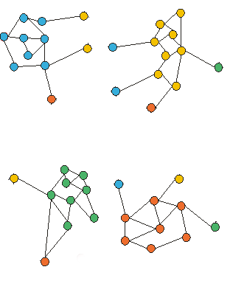
Id relabeling
0
1
8
10
9
2
3
4
8
11
14
1
13
Relabel node Ids and edge Ids:
All node/edge Ids in a partition fall in a contiguous range.
Why relabeling?
Mapping a node/edge to a partition requires large memory (#nodes/#edges in a graph).
Only a small array (#partitions) is required to map node/edge to a partition.
The distributed code doesn’t care about Id relabeling.
Node/Edge features are reshuffled accordingly.
6
7
12
16
5
14
7
15
26
24
Part 0
Machine 0
Part 1
Machine 1
13
17
18
7
15
16
19
20
24
25
21
23
26
27
22
22
28
29
25
30
Part 2
Machine 2
Part 3
Machine 3

Slide 9
Tools for graph partitioning
DGL provides graph partitioning in two forms:
API: dgl.distributed.partition_graph
Load a graph to DGL in a customized way.
More controls for load balancing.
Python script: tools/partition.py
Input graph: a file that stores a graph in the DGL format.
Pre-defined load balancing.

Slide 10
Partition results
A JSON file to store the partition configurations.
Node/edge mapping file (optional)
If node/edge Id relabeling is enabled, there is no node/edge mapping files.
Data for each partition (in the DGL format)
Graph structure of a partition.
Features of nodes that belong to the partition.
Features of edges that belong to the partition.
data_root_dir/
|-- graph_name.json
|-- node_map.npy
|-- edge_map.npy
|-- part0/
|-- node_feats.dgl
|-- edge_feats.dgl
|-- graph.dgl
|-- part1/
|-- node_feats.dgl
|-- edge_feats.dgl
|-- graph.dgl
….

Slide 11
Distributed components for trainer processes

Slide 12
DistGraph
A Python class in the trainer process for accessing the graph structure and node/edge features in the cluster of machines.
Execution mode: distributed vs. standalone
Standalone: model development and testing.
Distributed: run code in a cluster.
No code change when switching between standalone and distributed.
Part 0
Machine 0
Part 1
Machine 1
Part 2
Machine 2
Part 3
Machine 3
DistGraph
DistGraph
DistGraph
DistGraph
Trainer
Trainer
Trainer
Trainer

Slide 13
DistGraph creation
Distributed mode:
Graph data is loaded by DGL servers.
DistGraph connects to the DGL servers.
Standalone mode:
data is loaded by DistGraph.
>>> import dgl
>>> g = dgl.distributed.DistGraph(‘ip_config.txt’, ‘graph_name’)
>>> import dgl
>>> g = dgl.distributed.DistGraph(‘ip_config.txt’, ‘graph_name’, part_config=’data/graph_name.json’)

Slide 14
Data access in DistGraph
Access graph structure:
The access to the graph structure is very limited.
Access node/edge data:
ndata
edata
>>> print(g.number_of_nodes())
>>> g.ndata[‘train_mask’]
<dgl.distributed.dist_graph.DistTensor at 0x7fec820937b8>
>>> g.ndata[‘train_mask’][0]
tensor([1], dtype=torch.uint8)

Slide 15
Distributed tensor
dgl.distributed.DistTensor accesses tensors sharded in a cluster of machines.
Data is accessed with global row Ids.
Part 0
Machine 0
Part 1
Machine 1
Part 2
Machine 2
Part 3
Machine 3
read
write
DistTensor
DistTensor
DistTensor
DistTensor
Trainer
Trainer
Trainer
Trainer

Slide 16
Operations on DistTensor
Create DistTensor
Allocate memory if the tensor identified by the tensor name doesn’t exist in the cluster.
Reuse the tensor if the tensor identified by the tensor name exists.
This is a synchronized operation.
Read DistTensor: copy specified rows to the local process.
Write DistTensor: write data to the specified rows.
>>> tensor = dgl.distributed.DistTensor(g, (g.number_of_nodes(), 10), th.float32, ‘test’)
>>> data = tensor[0:100]
>>> tensor[0:100] = data

Slide 17
Distributed Embedding
Some models (e.g., DeepWalk) require learnable embeddings.
dgl.distributed.DistEmbedding accesses embeddings sharded in a cluster of machines.
Data is accessed with global row Ids.
Update embeddings with DGL’s sparse optimizer.
Part 0
Machine 0
Part 1
Machine 1
Part 2
Machine 2
Part 3
Machine 3
read
Update with
gradients
DistEmbedding
DistEmbedding
DistEmbedding
DistEmbedding
Trainer
Trainer
Trainer
Trainer

Slide 18
Operations on Distributed Embeddings
Create DistEmbedding
Allocate memory if the embeddings identified by the name doesn’t exist in the cluster.
Reuse the embeddings if the embeddings identified by the tensor name exists.
This is a synchronized operation.
Read DistEmbedding: copy specified rows to the local process.
>>> emb = dgl.distributed.DistEmbedding(g, g.number_of_nodes(), 10, ‘test’)
>>> data = emb(np.arrange(100))

Slide 19
Operations on Distributed Embeddings
Update embeddings with DGL’s sparse optimizer.
Currently, DGL provides dgl.distributed.SparseAdagrad.
When step is invoked, the embeddings of row 0, 1, 2, 3 are updated by SparseAdagrad.
>>> optimizer = dgl.distributed.SparseAdagrad([emb], lr=0.001)
>>> feats = emb([0,1,2,3])
>>> loss = th.sum(feats + 1)
>>> loss.backward()
>>> optimizer.step()

Slide 20
Graph sampling
DGL provides distributed sampling
Sample seed nodes/edges
Sample neighbors: dgl.distributed.sample_neighbors
The high-level sampling APIs (e.g., NodeDataLoader, EdgeDataLoader) work for both DGLGraph and DistGraph.
>>> sampler = dgl.dataloading.MultiLayerNeighborSampler([10, 25])
>>> train_dataloader = dgl.dataloading.NodeDataLoader(
g, train_nid, sampler,
batch_size=1024,
shuffle=True,
drop_last=False
)

Slide 21
Split training, validation and test set
Store the training/validation/test set in global mask tensors in preprocessing.
Get nodes/edges from the training set in a trainer process.
>>> g.ndata['train_mask']
>>> train_nid = dgl.distributed.node_split(g.ndata['train_mask'])

Slide 22
Invoke distributed training

Slide 23
Copy partitions to the cluster
DGL provides a data copy script to copy partitions
It requires ssh passwordless access between machines.
Copy a partition to the right machine.
Update the partition configuration file automatically.
python3 copy_partitions.py --ip_config ip_config.txt \
--workspace ~/graphsage/ \
--rel_data_path 4part_data --part_config 4part_data/ogb-product.json

Slide 24
Launch distributed training
DGL provides a launch script to run distributed training and inference in a cluster of machines.
It requires ssh passwordless access between machines.
The script launches the servers and trainers on the cluster of machines.
python3 ~/dgl/tools/launch.py \
--workspace ~/graphsage/ \
--num_clients 2 \
--part_config data/ogb-product.json \
--ip_config ip_config.txt \
"python3 train_dist.py --graph-name ogb-product --ip_config ip_config.txt --num-epochs 30 --batch-size 1000 --lr 0.1"

Slide 25
Next
Jupyter Notebook to demonstrate graph partitioning.
Jupyter Notebook to demonstrate the basic operations on distributed components (DistGraph, DistTensor, etc).
Jupyter Notebook to demonstrate distributed GraphSage for node classification.
Jupyter Notebook to demonstrate distributed GraphSage with embeddings for node classification.
Convert the Notebooks into training scripts and run distributed training on a cluster.

